Slide 1

Automated Task Email Reminder
Streamlining Task Management with Automated Reminder
Razel Rolan | GitHub: rnrolan | edX: rolanrazel
Cebu, Philippines | 07. 06. 2024

Slide 2
CONTENTS
01.
Project Overview
03.
Demonstration
Automating task reminders based on due dates and task statuses
Showcasing the functionality of automated email reminders
Project Overview
Code Walkthrough
Demonstration
Conclusion
02.
Code Walkthrough
04.
Conclusion
Technical details of data loading, querying, and SMTP email sending
Efficiency and productivity improvements from automated task reminders with Google Sheets integration

Slide 3
PROJECT
OVERVIEW
Objective
Automate task management through scheduled email reminders
Functionality
Send reminders based on task due dates and status updates
Integration
Utilize Google Sheets for data management and SMTP for email delivery
Benefits
Reduce manual effort, ensure timely task completion, and enhance overall efficiency

Slide 4
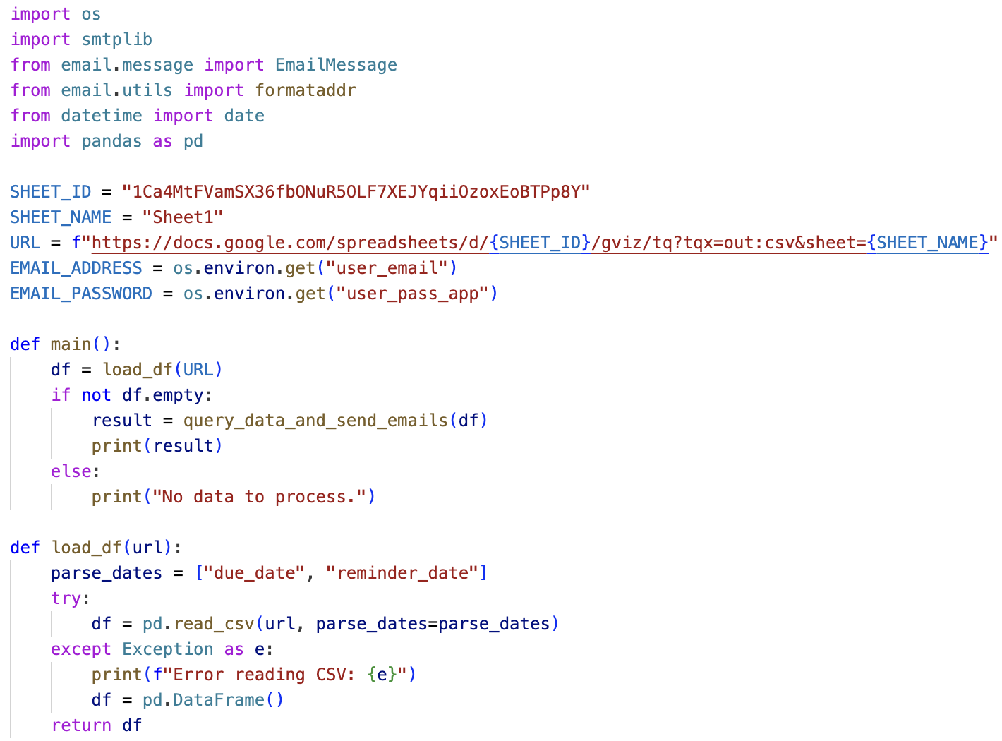
CODE WALKTHROUGH
IMPORTS AND CONSTANTS
The script imports `os` for environment variables and `smtplib` for sending emails. `EmailMessage` and `formataddr` help format emails. `date` from `datetime` is used for date comparisons, and `pandas` handles Google Sheets data. Key constants like `SHEET_ID`, `SHEET_NAME`, `URL`, EMAIL_ADDRESS, and EMAIL_PASSWORD are defined.
MAIN FUNCTION
The `main()` function loads the data frame using `load_df()`. If data is present, it processes and sends emails via `query_data_and_send_emails()`. This function manages the workflow and error handling.
LOADING DATAFRAME
The load_df(url) function reads data from the URL, parsing due_date and reminder_date as dates. If reading fails, it returns an empty DataFrame and prints an error message.

Slide 5
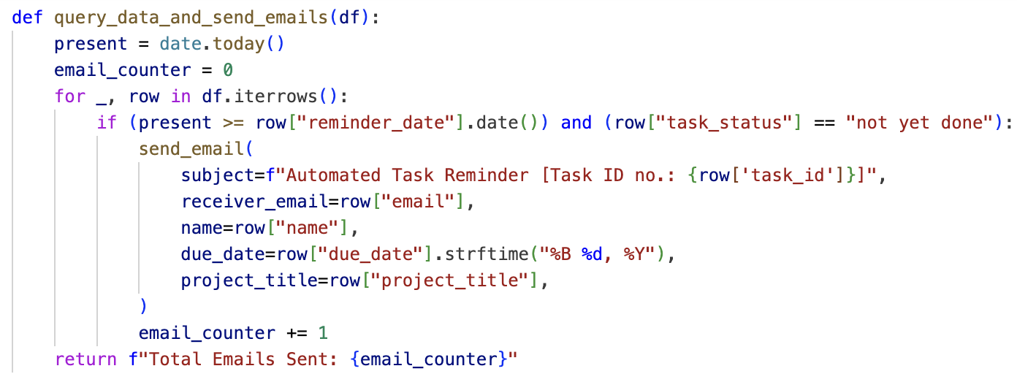
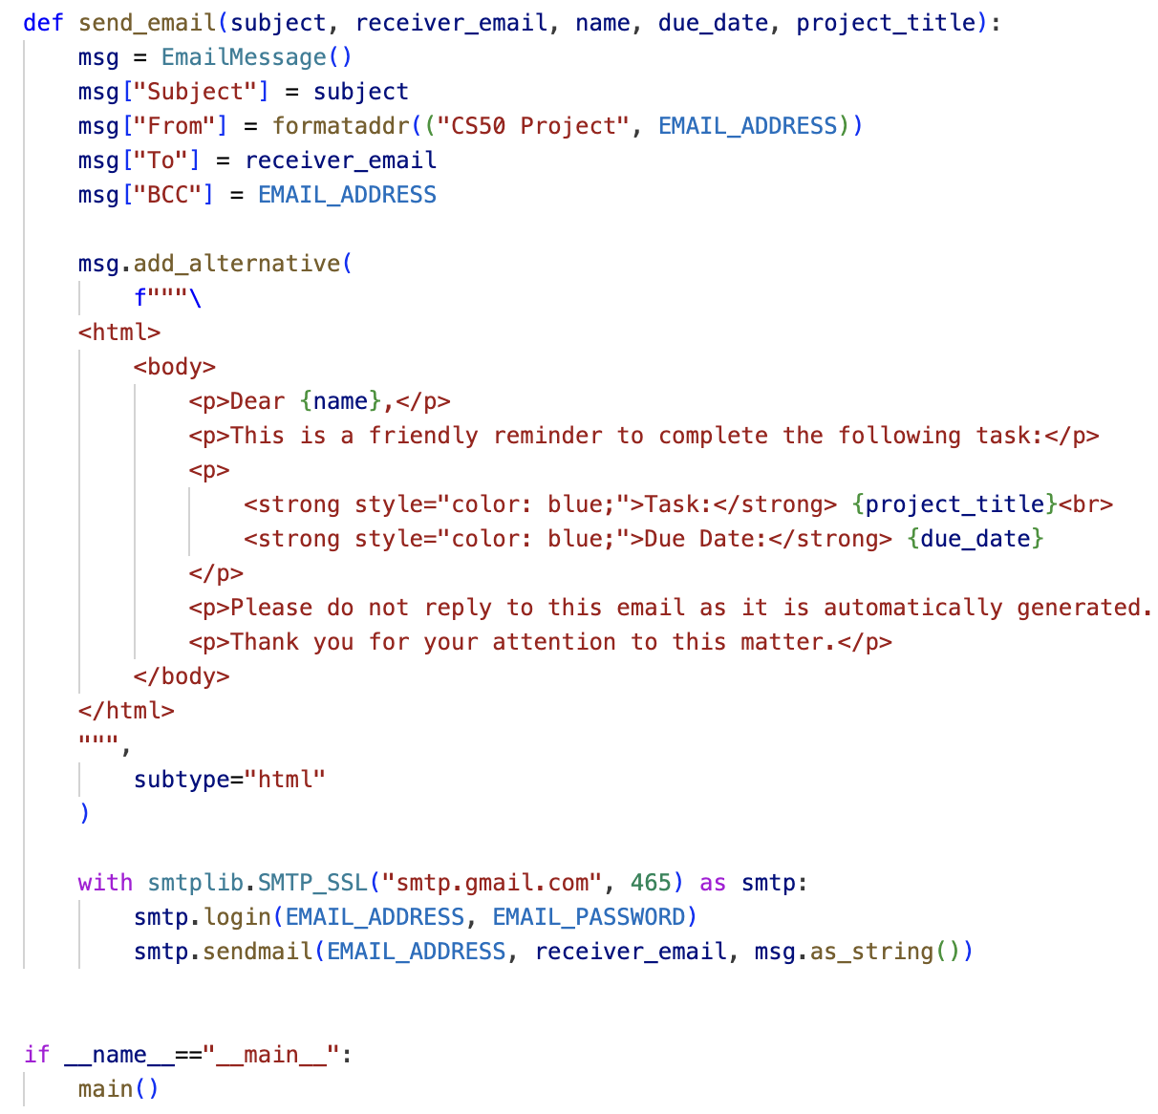
QUERY AND SEND EMAILS
The query_data_and_send_emails(df) function filters tasks needing reminders by checking reminder_date and task_status. It calls send_email() for each relevant task and returns the email count.
SENDING EMAIL
The send_email(subject, receiver_email, name, due_date, project_title) function sets up and sends the email. It formats the subject, sender, receiver, BCC, and email body using HTML, and sends the email via SMTP.

Slide 6
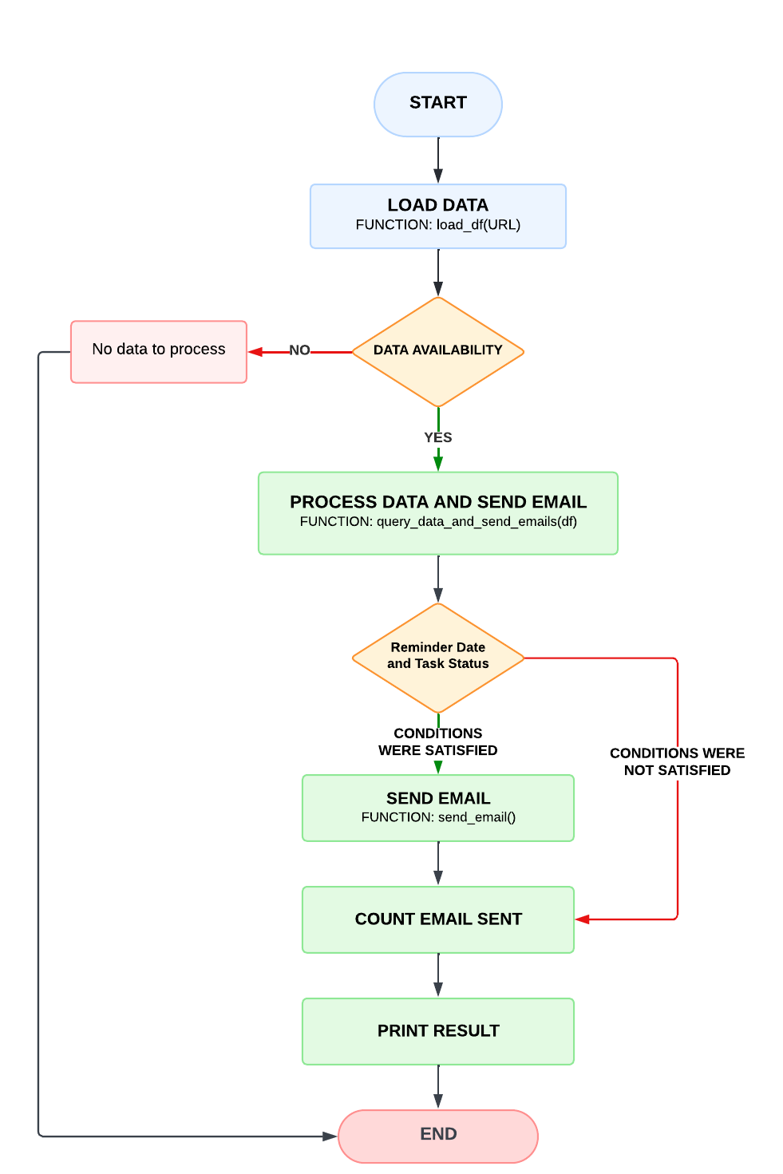
Automated Task Reminder System Flowchart
This flowchart represents the overall structure and flow of the code, from starting the script to loading data, checking conditions, sending emails, and printing the result.

Slide 7
DEMONSTRATION
This demonstration showcases an automated task reminder system in Python, designed to send timely email reminders based on data from Google Sheets.

Slide 8
CONCLUSION
Summary of Accomplishments
Automated task reminder system
Integration with Google Sheets
Timely email reminders sent
Learning Outcomes
Practical Python automation
Data handling with pandas
Email sending with smtplib
Benefits
Streamlined task management
Reduced manual follow-ups
Improved efficiency and organization

Slide 9
Thanks !

